Slide 1
Hackademia Project
x86 emulator
Team Members: Chloe Belletti, Preston Buterbaugh, Madilyn Coulson, Isabella Hall
Project Advisor: Giovani Abuaitah

Slide 2
Project Background and Goals
This project was completed for Computer Science professor Dr. Giovani Abuaitah, who teaches classes involving assembly code, and would like to have a tool that allows students to see how their C code translates to assembly instructions, and how these instructions act on the CPU.
This project is a continuation of a project from last year, which was a simple web-based x86 assembly code emulator, that showed a snippet of C code, its corresponding assembly code, and allowed the user to step through the code and see how the stack and registers update, to better understand assembly code, and how C code converts to assembly.
The limitation of the existing emulator, is that it is completely static. The goal of our project is to allow the user to write their own C code, which would be compiled to assembly in real time. This assembly code must then also be interpreted in real time to correctly update the registers and stack based on the effect of each assembly instruction.

Slide 3
Intellectual Project Merits
Interesting Project Aspects and Innovative Contributions
Currently, no known existing tools that provide the ability to dynamically insert C code, view the corresponding assembly code output, and step through the stack and registers values in real time
Although there are tools that handle C to assembly conversion, the dynamic nature and stack/register animation are extremely unique
Integration of the ICED x86 disassembler offers a fast, efficient way to disassemble hex code into assembly language
Utilization of Linux command line tools to compile C code into a string of hex values introduces a powerful way to extract low-level code bits
Creation of UI components using React and its libraries to create an interactive, friendly user interface
Encompasses a full stack development approach with both front and back end development
Encourages innovation and problem-solving in all areas of development, rather than focusing in one area

Slide 4
Broader Project Impacts
This project will be useful in in the world of academia because it allow students and professors a very visual and interactive way to understand and teach how the language is transformed
It will be useful to anyone that wants to better understand and practice converting C to Assembly
It can be expanded as well to showcase larger and more intensive programs
Typically students struggle to understand low level programming and how stacks and registers work so it will overall help close that
It can encourage people to pursue computer science by sparking their interest with an interactive tool
It could serve as a model for other developer tools to how languages convert

Slide 5
Design Specifications
UI that allows the user to type in their own C code
UI that allows user to compile correctly formatted C code
UI that shows the user how code runs through the stack and registers
UI that allows for dynamic changes
Backend that correctly transforms C code to the corresponding assembly instructions
Error messages for incorrect formatting or invalid code

Slide 6
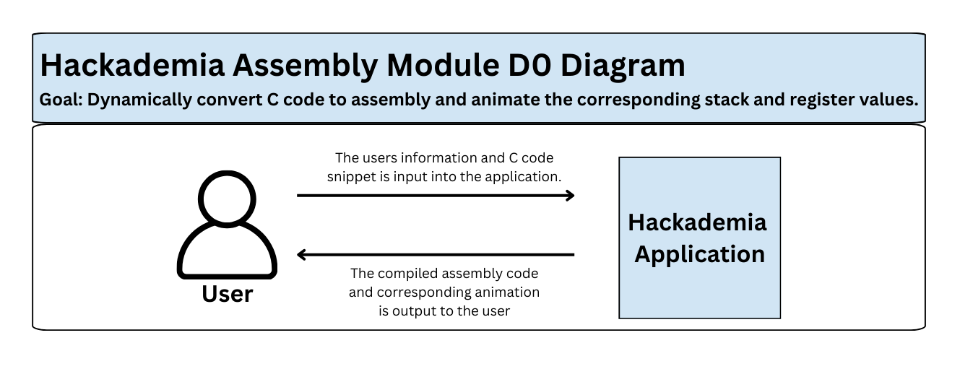
Design Specifications Diagrams

Slide 7
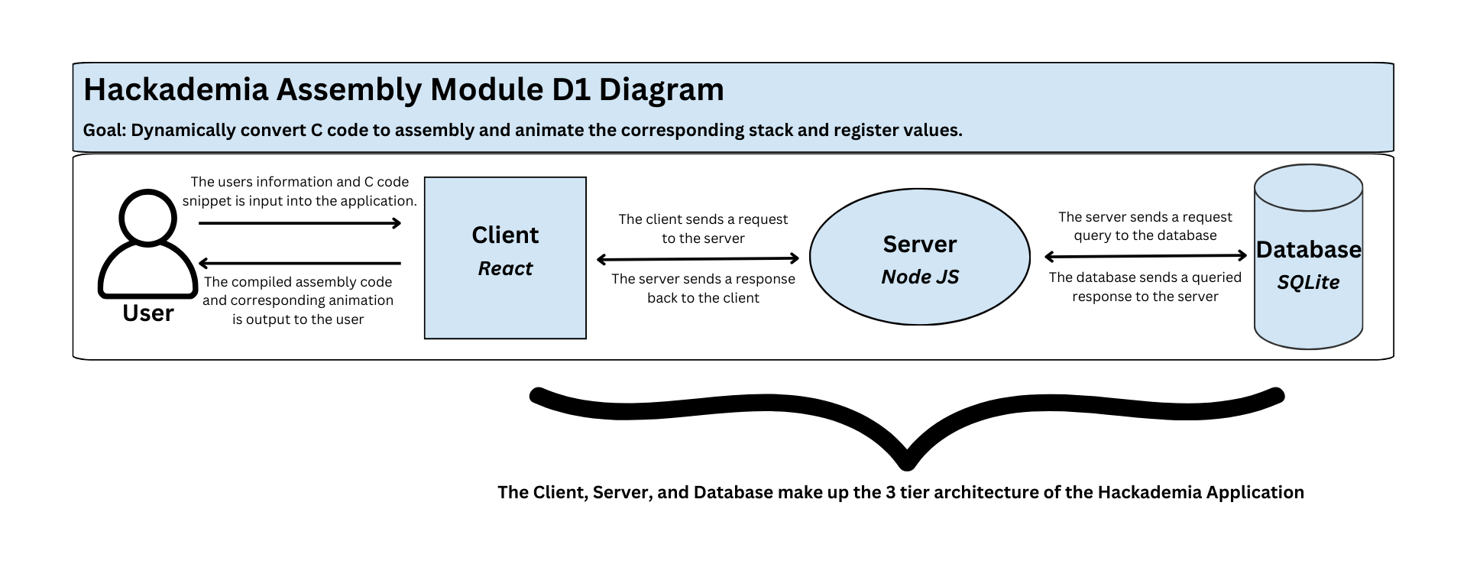
Design Specifications Diagrams

Slide 8
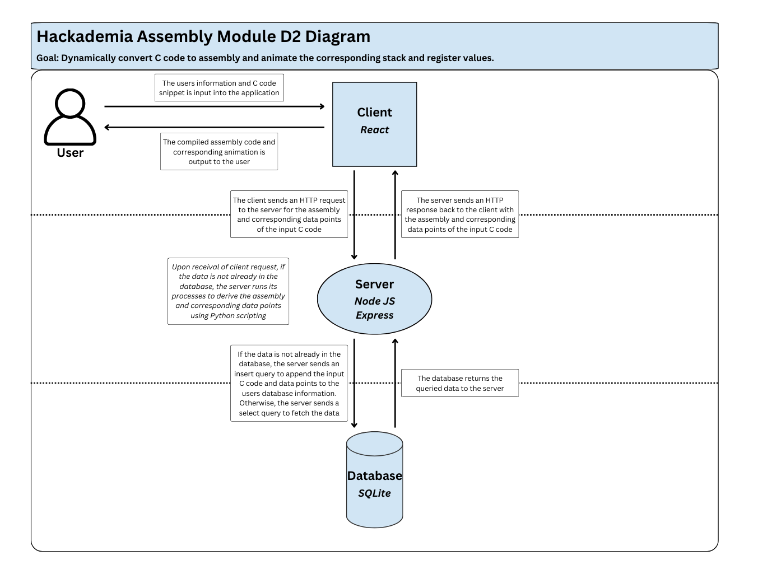
Design Specifications Diagrams

Slide 9
Technologies
The app uses a client-server model, in which the user primarily interacts with the frontend web app, which sends C code using the HTTP protocol to the server to be compiled
The server makes use of the GCC compiler, and various Linux commands for inspecting object code, such as the xxd command, to convert the C code into binary machine code, which is then sent back to the client in an HTTP response
The client utilizes the Iced x86 disassembly library to convert the machine code into human readable assembly code
The web app frontend is built in the React framework, written in TypeScript
The server is written in NodeJS

Slide 10
Project Milestones
Generate Assembly code when the user inputs C code
Update the UI to utilize bootstrap components and allow users to insert code
Dynamically generate stack/register information for each line of generated Assembly code
Create animations for the corresponding stack/register information to display to the user
Allow for the user to toggle what type of Assembly code they want to view

Slide 11
Review of Project Progress and Results
Current Project Results
Users can insert C code into the UI, with a main and helper function
C code is sent to the server, where it is compiled into a string of hex code
Server sends hex code string back to the client, which uses ICED to disassemble it into assembly language
The assembly language code is displayed in the UI
Initial implementation of stack and register correspondence and animation has begun
Finishing Tasks
Complete stack and register animation for stepping through assembly code
Refine and enhance UI to create a more user-friendly experience
Implement testing and error handling in both the server and client

Slide 12
Challenges
Backend Challenges:
Challenge: Determining whether to create our own disassembler, or utilize an existing open source library. Additionally, researching and implementing an existing library.
Solution: Implemented existing ICED x86 library to decode hex into assembly
Challenge: Extracting hex code from C object files.
Solution: Created a series of Linux command line steps to successfully retrieve the hex in a string format
Frontend Challenges:
Challenge: Navigating the existing code structure of the front-end and determining whether to work with what we have or start from scratch.
Solution: Created a new module and used the existing ones for reference
Challenge: Creating new styled components for everything in the module
Solution: Utilized bootstrap to use their styled components

